Slide 1


Department of Computer Application
KIET Group of Institutions Muradnagar(GZB)
U.P.-201206
Project members:
Shagun Sharma
Rahul Pal
Rajul Sahu
Project guide:
Prof. Ankit Verma

Slide 2

Real time health monitoring system

Slide 3
Introduction
In emergency, the patient health monitoring system plays the vital role to maintain the patient's vital signs. The increased use of electronics and mobile technologies, makes it easy to monitor of things on the internet.
Patient health monitoring by using IoT along with smart sensor system enables the health expert to monitor the patient from office, home or anywhere from this globe.
Wireless Sensor Network (WSN's) are very promising for monitoring extraordinary diverse environments. The use of WSN consists of wireless nodes that can sense some physical information , process and transfer to the destination by wireless ad-hoc networks.

Slide 4
OBJECTIVE
The aim of this project is to provide people with proper records of that person's health and a convenient way to provide emergency measures.

Slide 5
Hardware & software used
Internet of Things.
Sensors.
Bluetooth Connectivity.
GPS and GSM.
Arduino Board

Slide 6
Literature review
Wireless sensor networks (WSN’s) and Internet of Things (IoT) have strongly emerged in the medical field for healthcare of the patient for data collection regarding the physical, psychological, cognitive and behavioral processes for monitoring purposes.
In the figure below it shows that how the proposed system will work, and it take all the vitals and processed the information and send it to the emergency services to initiate the alert.

Slide 7
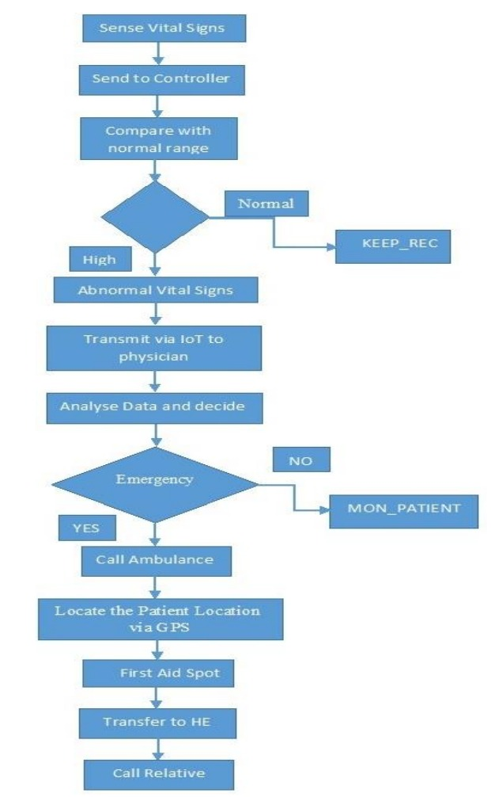

Slide 8
Internet of things
The internet of things, or IoT, is a system of interrelated computing devices, mechanical and digital machines, objects, animals or people that are provided with unique identifiers ( UIDs) and the ability to transfer data over a network without requiring human-to-human or human-to-computer interaction.
The Internet of things (IoT) describes physical objects (or groups of such objects) with sensors, processing ability, software, and other technologies that connect and exchange data with other devices and systems over the Internet or other communications networks.

Slide 9
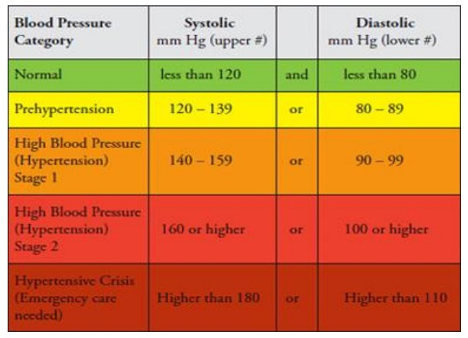
Blood Pressure Sensor
The blood pressure depend on the flow of the blood, if the is normal flow, then blood pressure is normal (120/80), but If there is problem in the blood flow the pressure goes up. If high blood pressure goes undetected, the person is at risk of severe medical problems.

Slide 10
Temperature sensor
This unit measures the temperature of patient and it also known as analog temperature sensor. The output voltage is linearly proportional to the temperature in Celsius and to measure the body temperature solid state technology is used. If the temperature increases mean voltage also increases. The analog signal is generated due the change of voltage that is directly proportional to temperature

Slide 11
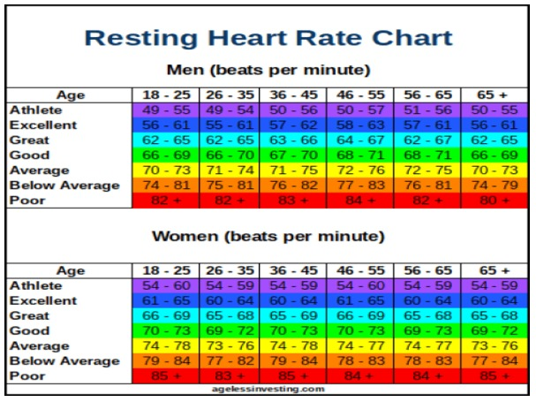
Heartbeat rate
A sensor unit is integrated in wrist band and it is weared by patient in left wrist and it measures the heartbeat by using the defined interval and send it to the central unit where it is processed. At central unit it is saved and compared with the standard and previous measurement, if it finds any abnormality in the heartbeat then it reported to concerned system and issues an alert.

Slide 12
Gps module
The Global Positioning System (GPS) module is a satellite navigation system that can be used to locate the positions anywhere on the globe. Designed and implemented by the Defense Department of the United States, which includes satellites, control and monitoring stations and receivers. GPS receivers receive training transmitted by satellites and uses triangulation to calculate the user's exact GPS location. This unit is very important to rescue the patient, by using the GPS, rescue services easily locate the affected person

Slide 13
references
[1] S.K. Sandeep and S.Sivanandam, “Intelligent Wireless Patient Monitoring and Tracking System (Using Sensor Network and Wireless Communication)”, IJIMS, 2014, Vol 1, No.3, 97-10.
[2] T. L. Alumona, V.E.Idigo and K.P. Nnoli, “Remote Monitoring of Patients Health using Wireless Sensor Networks (WSNs)”,International Journal of Electronics & Communication, Vol 2, Issue 9 , September 2014.
[3] U. Varshney, “Pervasive Healthcare: Applications, Challenges and Wireless Solutions,” Communications of the Association for Information Systems, Vol. 16, No. 1, 2005, p.3.

Slide 14
Any questions?

Slide 15
Thank you !

